Slide 1
STOCK MARKET ASSISTANT
By
Nikhil khemchandani (180410107039)
Gaurav Tilokani (180410107121)

Slide 2
Definition:
Stock Market Assistant is a system which helps naive investors to invest into the best stocks available. It was encountered that many people suffered financially by loosing their jobs in COVID-19 and many students also want to generate their passive income from some source. For these problems investing in stock markets is one of the best solution. But many people don’t have any knowledge about the stocks to invest in. Hence, this system will is developed to help these type of people get stock’s future price prediction and analysis.

Slide 3
Feasibility Study:
Technical Feasibility: Will provide:
- Graphical representation of stocks.
- predicted stock prices.
- Provides analysis of stocks.
Time Feasibility: Can be completed in 3-4 months.
Economic Feasibility: All the resources are free of cost.
- Most of them are open source libraries and frameworks.

Slide 4
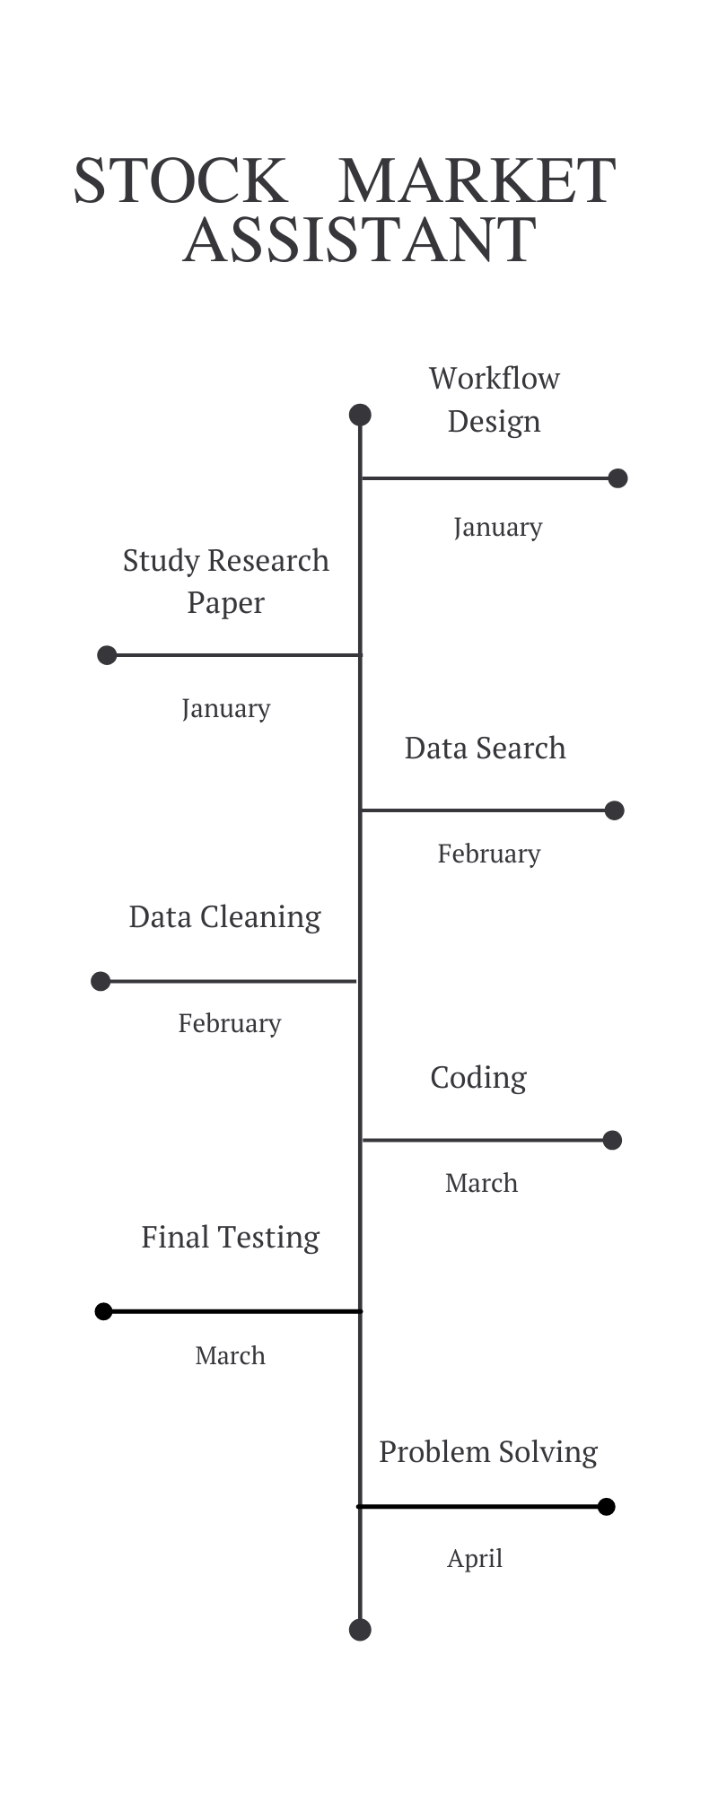
Time-Line Chart:

Slide 5
Requirement Gathering:
Functional Requirements: System should be able to generate approximate stock price and provide proper analysis of stocks.
Non Functional Requirements: System should have simple user interface and should work efficiently in less amount of time.
Hardware Requirements: A decent machine with internet connection.
Software Requirements: Visual Studio, Python libraries.

Slide 6
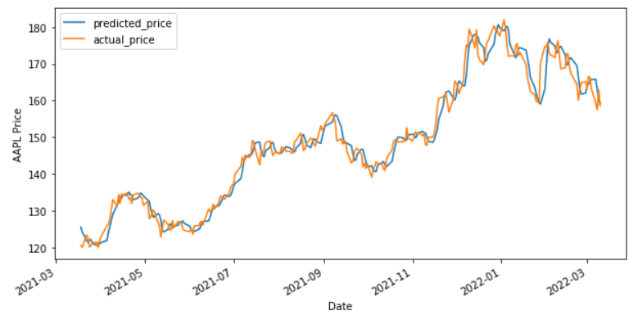
ML Model Research:
Linear Regression performs the task to predict a dependent variable value (y) based on a given independent variable (x). So, this regression technique finds out a linear relationship between x (input) and y(output).
Accuracy:93.78%

Slide 7
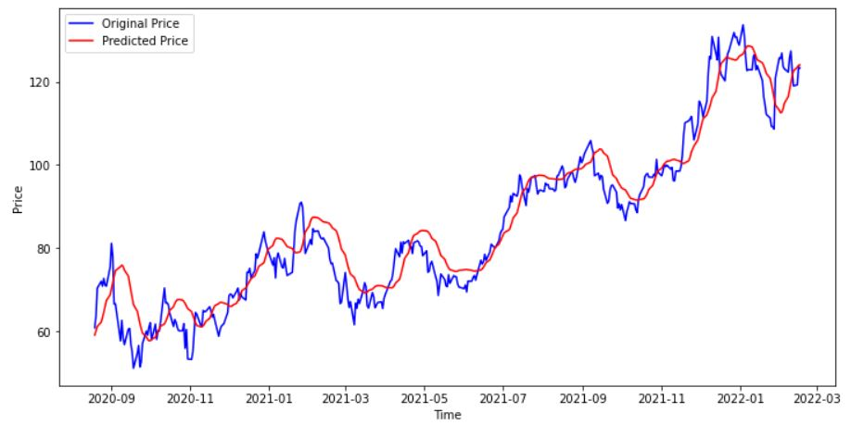
ML Model Research:
Decision Tree is a decision-making tool that uses a flowchart-like tree structure or is a model of decisions and all of their possible results, including outcomes, input costs, and utility.
Accuracy:91.04%

Slide 8
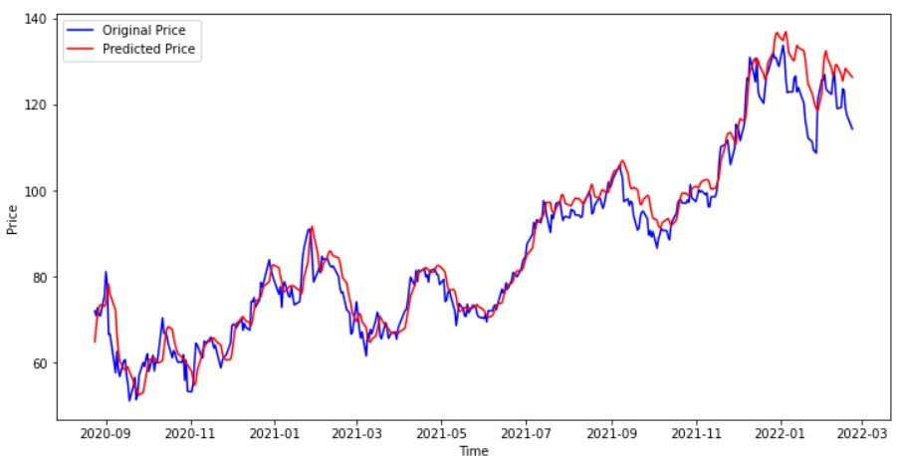
ML Model Research:
Long short-term memory (LSTM) is an artificial recurrent neural network (RNN) architecture used in the field of deep learning. Unlike standard feedforward neural networks, LSTM has feedback connections.
Accuracy: 95.36%

Slide 9
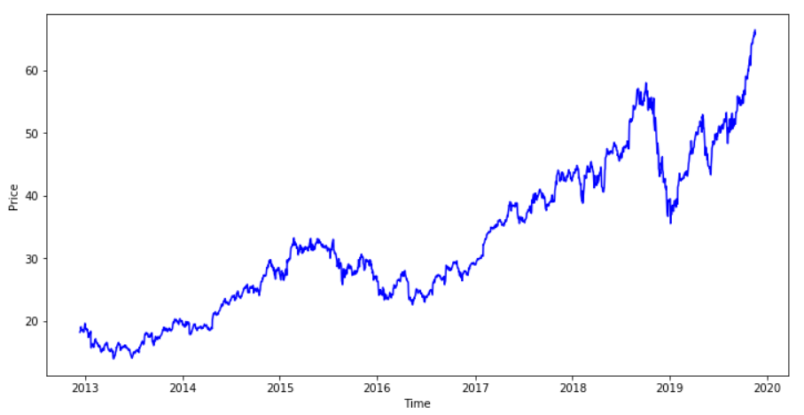
Analysis:
Visualization of closing price of stocks:

Slide 10
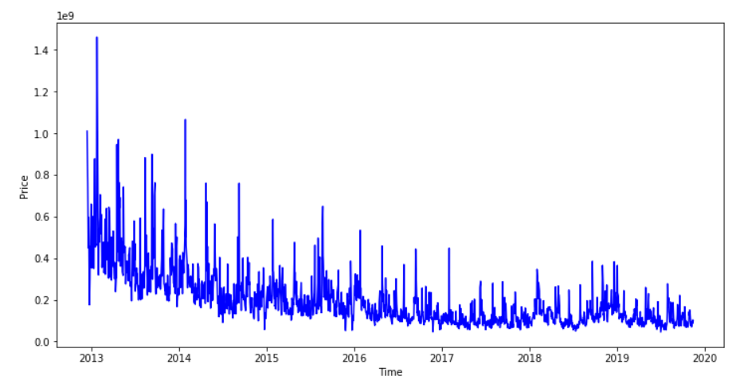
Analysis:
Visualization of Volume of stocks:

Slide 11
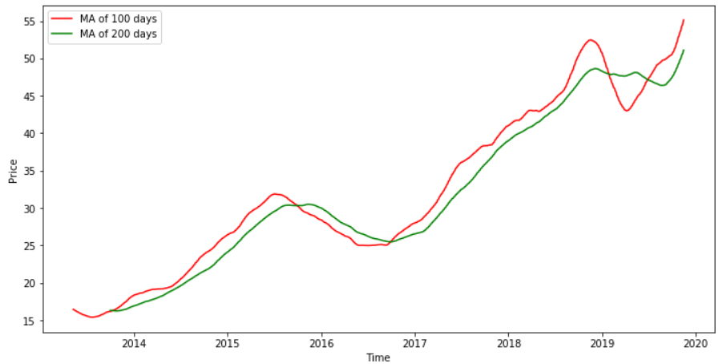
Analysis:
Moving Averages of stocks:

Slide 12
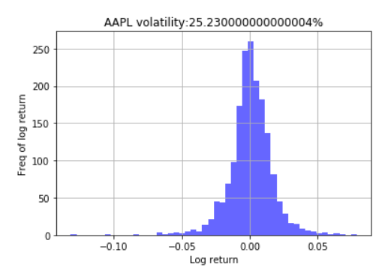
Analysis:
Volatility of Stocks:

Slide 13
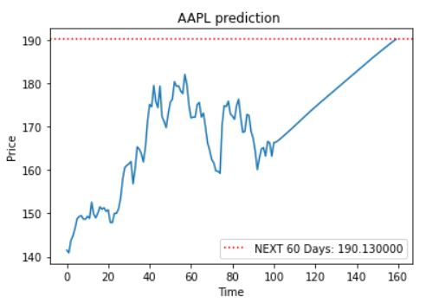
Price Prediction:

Slide 14
Thank you

